Slide 1

Autonomous Vehicles
PRESENTED BY :- SNEHAL TAWAR

Slide 2
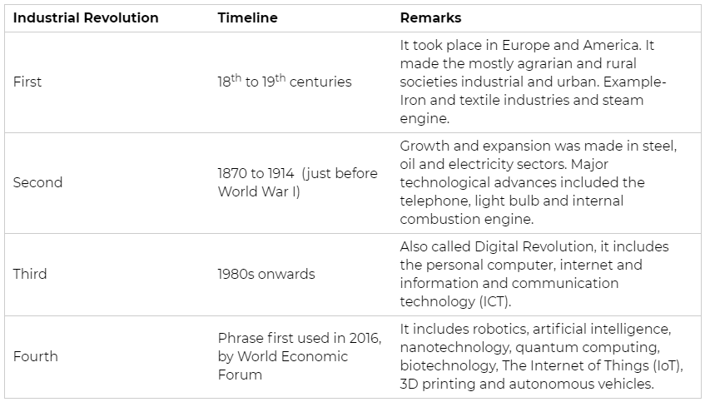
Fourth Industrial Revolution

Slide 3





History:
Some of the greatest scientific achievements — digital photography, virtual reality, the Deep Web and the Internet — trace their origins to military research.
The concept of self-driving cars too, owes a lot to the US wars in Iraq and Afghanistan. Competitions organised by Defense Advanced Research Projects Agency (DARPA) — a research and development wing of the Pentagon — in the mid-2000s have had a direct bearing on most of today’s autonomous vehicle (AV) projects.
The state of Play:
WAYMO
FORD
GENERAL MOTORS
TESLA
VOLVO

Slide 4
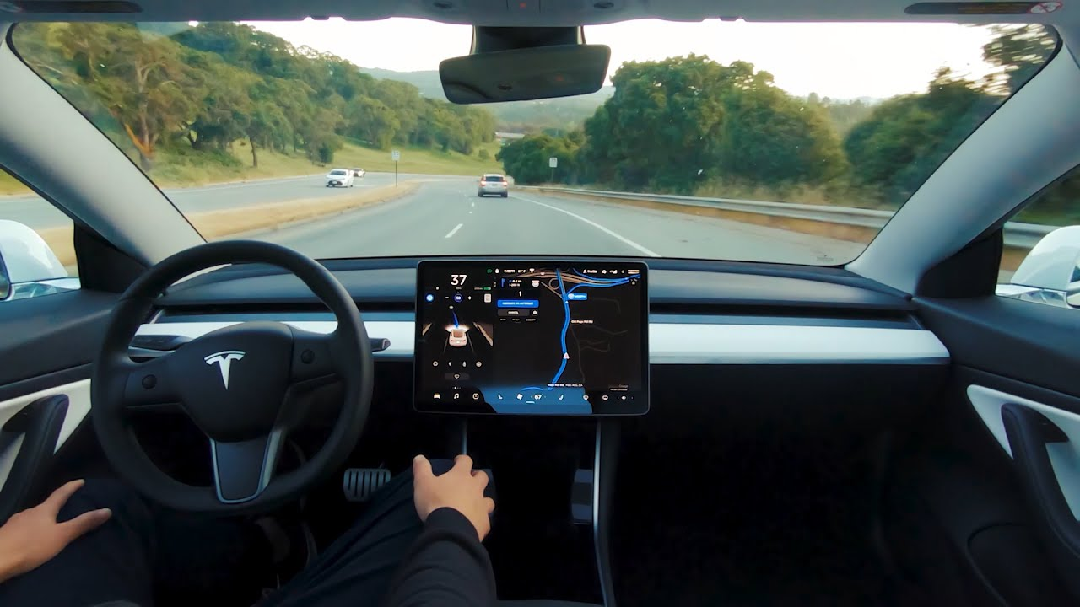
Cars
An autonomous car, also known as a robotic car, self-driving car, or driverless car, is a vehicle that is capable of sensing its environment and moving with little or no human input.
Autonomous cars combine a variety of sensors to perceive their surroundings, such as radar, lidar, sonar, GPS, odometry and inertial measurement units.
Advanced control systems interpret sensory information to identify appropriate navigation paths, as well as obstacles and relevant signage

Slide 5
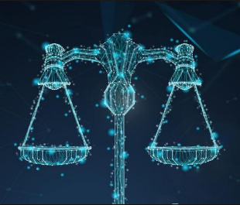

Legal Issues
The criminal laws are going to face drastic challenge.
If an AI based driverless car gets into an accident ; who will be responsible for that?
How will we come to know whether that happened knowingly ,unknowingly or carelessly ?
Several debates going on in the US about the regulation of AI.
Germany, Japan, Korea, China too are coming up with ethical rules.

Slide 6


Artificial Intelligence in INDIA
NITI Aayog released a policy paper ‘National strategy for Artificial Intelligence’ in June,2018.
NITI Aayog has joined hands with Google to promote the growth of artificial intelligence and a machine learning ecosystem in India.
The Solutions:
A strict liability scheme needs to be introduced so that the producer or manufacturer of the product is liable of harm.
Since Privacy is a fundamental right, certain rules to regulate the usage of data by an entity should be framed as a part of Personal Data Protection Bill,2018.

Slide 7
THANK YOU.

